Slide 1

Note: The data and information in this document is reflective of a hypothetical situation and client. This document is to be used for KPMG Virtual Internship purposes only.
Sprocket Central Pty Ltd
Data analytics approach

Slide 2
Note: The data and information in this document is reflective of a hypothetical situation and client. This document is to be used for KPMG Virtual Internship purposes only.
Agenda
Introduction
Data Exploration
Model Development
Interpretation

Slide 3
Note: The data and information in this document is reflective of a hypothetical situation and client. This document is to be used for KPMG Virtual Internship purposes only.
Introduction
Analysis of Bike Sales company Sprocket Central Pty Ltd
Sprocket Central Pty Ltd is a long-time client of KPMG and specializes in offering cyclists affordable and high-quality bicycles. By analyzing their current customer dataset to identify client trends and behavior, their marketing team hopes to increase sales.
Objectives of the Analysis
Understand the marketing numbers of the business such as the profits, customers demography, the products, the number of sales
Identify trends and relationships between the customers from the given datasets provided; customer demographic, transactions and customer address
Identify the top customers from the datasets based on their relationships with the products, location, timing and more.

Slide 4
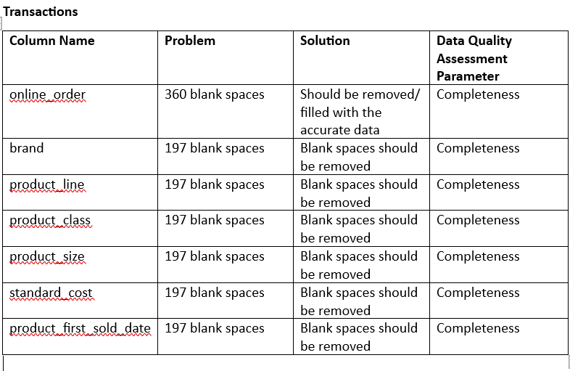
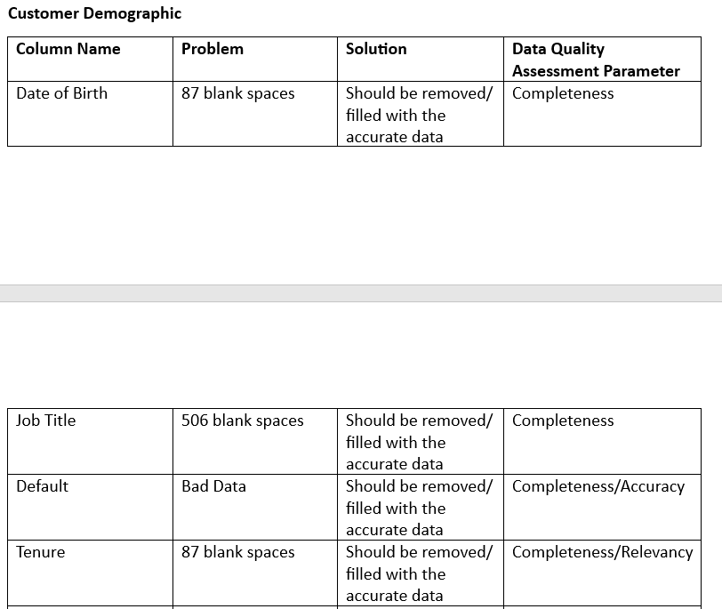
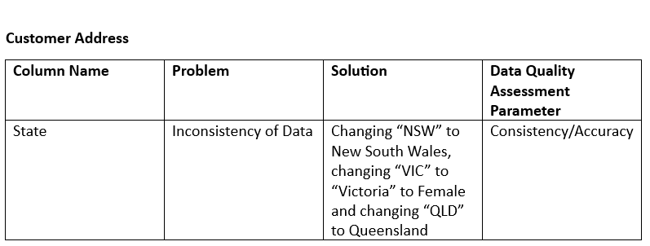
Note: The data and information in this document is reflective of a hypothetical situation and client. This document is to be used for KPMG Virtual Internship purposes only.
Data Exploration
Data Quality Evaluation
In the first phase of this analysis, I carried out a data quality assessment. Some underlying issues were found in the dataset. There issues include
Accuracy
Incompleteness
Relevance and Consistency

Slide 5
Note: The data and information in this document is reflective of a hypothetical situation and client. This document is to be used for KPMG Virtual Internship purposes only.
Data Exploration
Data Transformation
The next phase required data cleaning after the assessment of the dataset was carried out.
Some of the cleaning practices utilized in this dataset include
Correcting spellings to achieve consistency within the data i.e Changing “U” to Unidentified, changing “F” and “Femal” to Female and changing “M” to Male and Changing the “N” and “Y” to Yes and No
Eliminating bad, inaccurate and unnecessary data such as default column, customers without (date of birth, brand, transaction id, country, state) and so on to make the data relevant for use.
Combining the first and second name to a full name, calculating the current age of the customers and also grouping them into age brackets (Old, Adult, Young) for analysis.
Replacing any remaining blank spaces in the dataset with N/A or Unidentified.

Slide 6
Note: The data and information in this document is reflective of a hypothetical situation and client. This document is to be used for KPMG Virtual Internship purposes only.
Data Exploration
Exploratory Process
This phase entails a general exploration of the dataset
Some of the exploratory analysis utilized in this dataset provided us with some insights which include
There is a some what a positive correlation between the young/adult age bracket and number of bike related purchases in the last three years but a visible negative correlation can be seen as the age approaches 50 upwards and bike purchases.
More relationships can be seen between the age and tenures. There is an upward correlation between the age and tenure as people from the adult tend to have a longer tenure than those in the younger bracket, most of them tend to peak in their early 40s and begin reducing from there 50s down. Almost identical as that of the age and bike purchases.
Most notably, there wasn’t any correlation found between the numbers of bike related items purchased and profit generated.

Slide 7
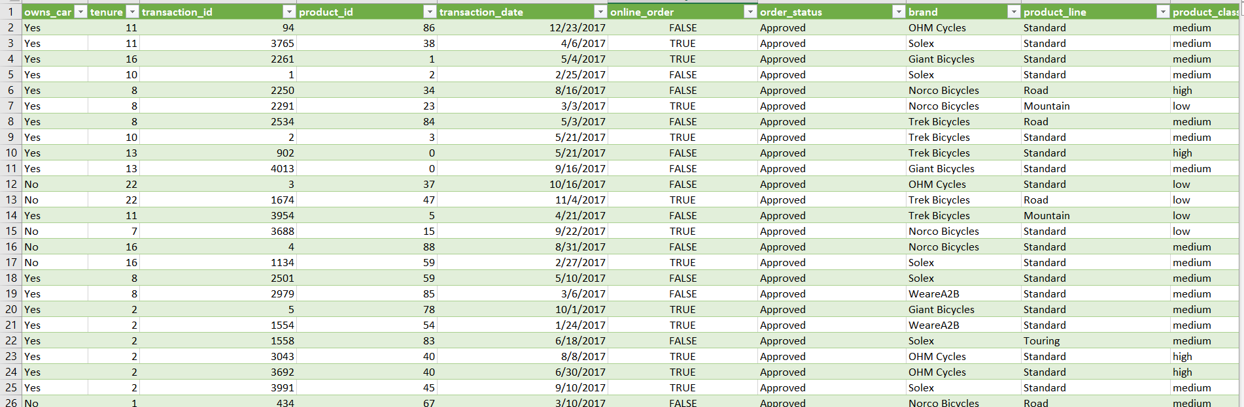
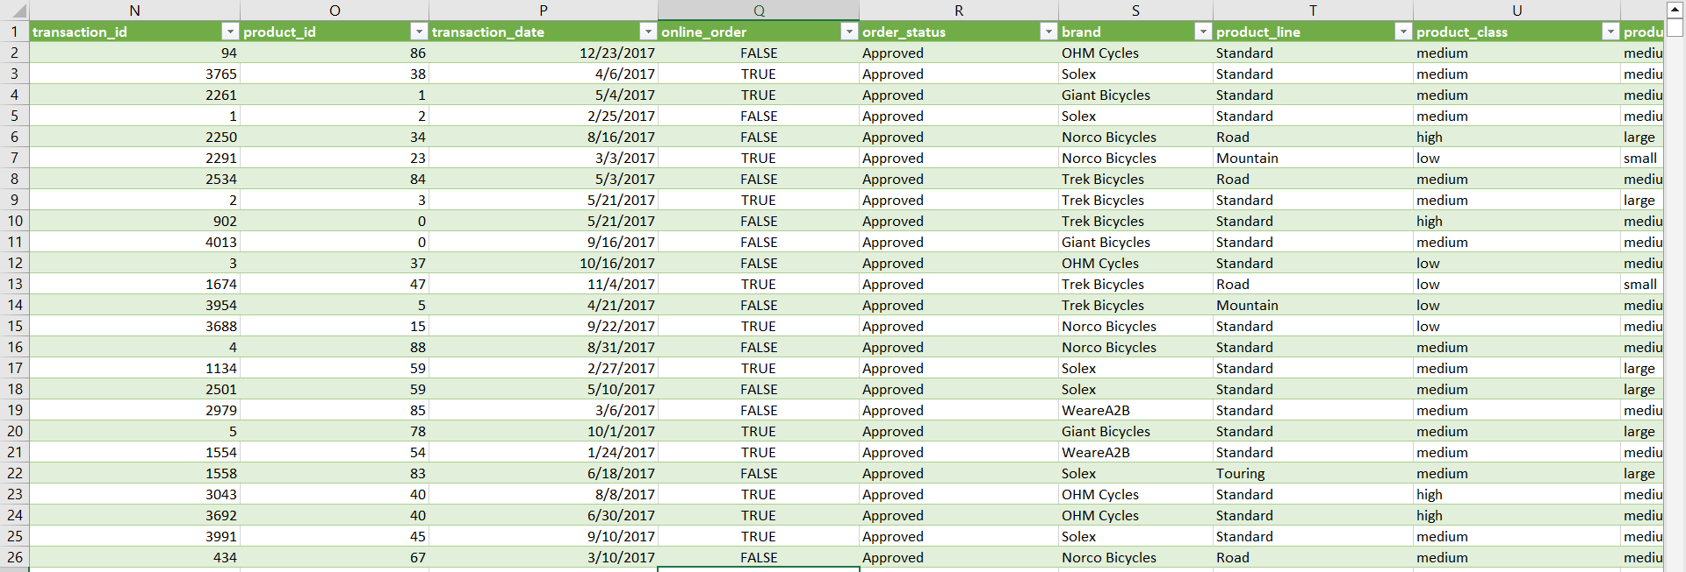
Note: The data and information in this document is reflective of a hypothetical situation and client. This document is to be used for KPMG Virtual Internship purposes only.
Model Development
Power Query was utilized to merge these datasets into one worksheet
Transactions
CustomerDemographic
CustomerAddress
Using customer_id as the unique key in all of the sheets to achieve these purpose
calculating the current age of the customers and also grouping them into age brackets (Old, Adult, Young) for analysis.

Slide 8
Note: The data and information in this document is reflective of a hypothetical situation and client. This document is to be used for KPMG Virtual Internship purposes only.
Interpretation
Profit and Past 3 years purchases based on Age Brackets
Customers within the adult age brackets account for up to 60% of the profit made while young people have a low turnout of 7%
This same can be for the bike purchases in the last 3 years where the adult age bracket have purchased more bikes when compared to the young or the old age brackets

Slide 9
Note: The data and information in this document is reflective of a hypothetical situation and client. This document is to be used for KPMG Virtual Internship purposes only.
Appendix

Slide 10
Note: The data and information in this document is reflective of a hypothetical situation and client. This document is to be used for KPMG Virtual Internship purposes only.
Appendix
This is an optional slide where you may place any supporting items.

